Slide 1
UNIT -IV
SPARK With Machine Learning

Slide 2
Designing a Machine Learning System
A modern large-scale data environment includes the following requirements:
It must integrate with other components of the system, especially with data collection and storage systems, analytics and reporting, and frontend
applications.
It should be easily scalable and independent of the rest of the architecture. Ideally, this should be in the form of horizontal as well as vertical scalability.
It should allow efficient computation in respect of the type of workload in mind, that is machine learning and iterative analytics applications. If possible, it should support both batch and real-time workloads.

Slide 3
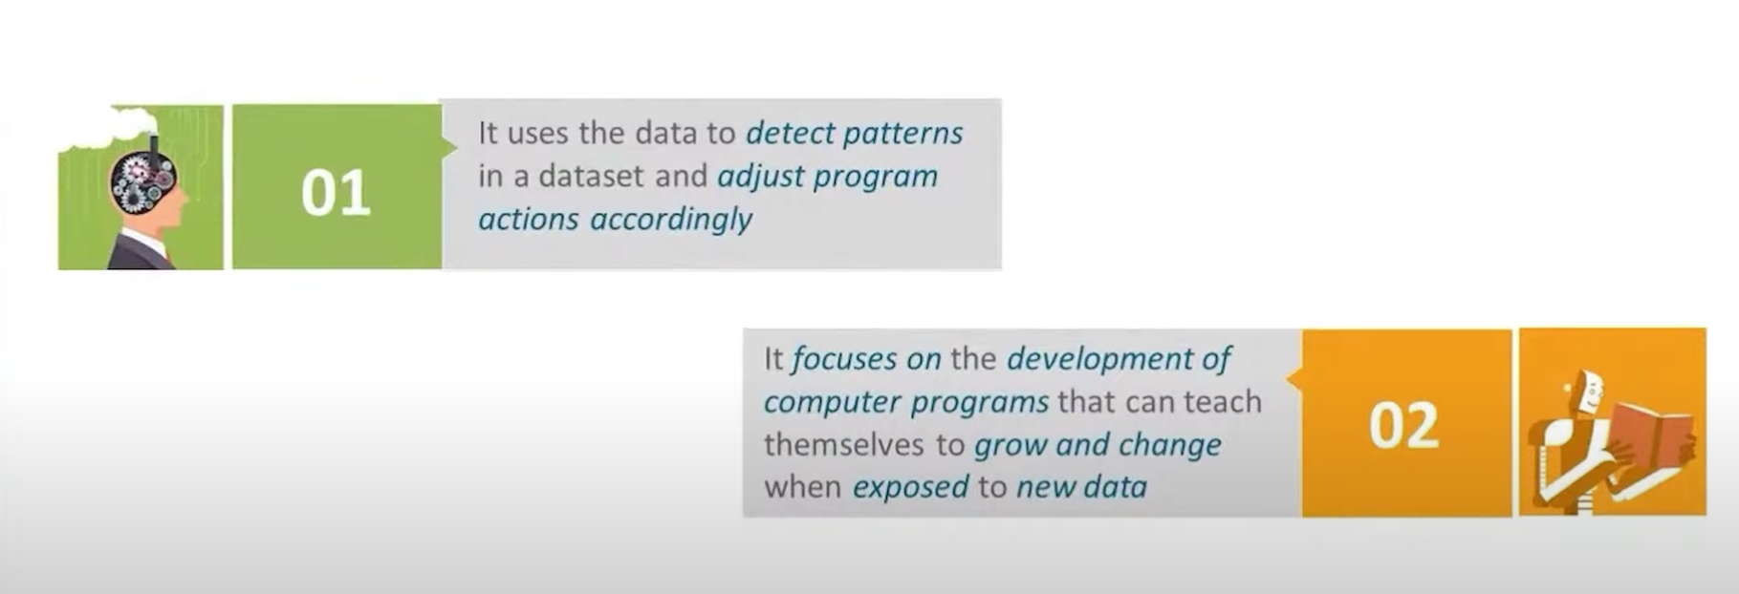

Slide 4
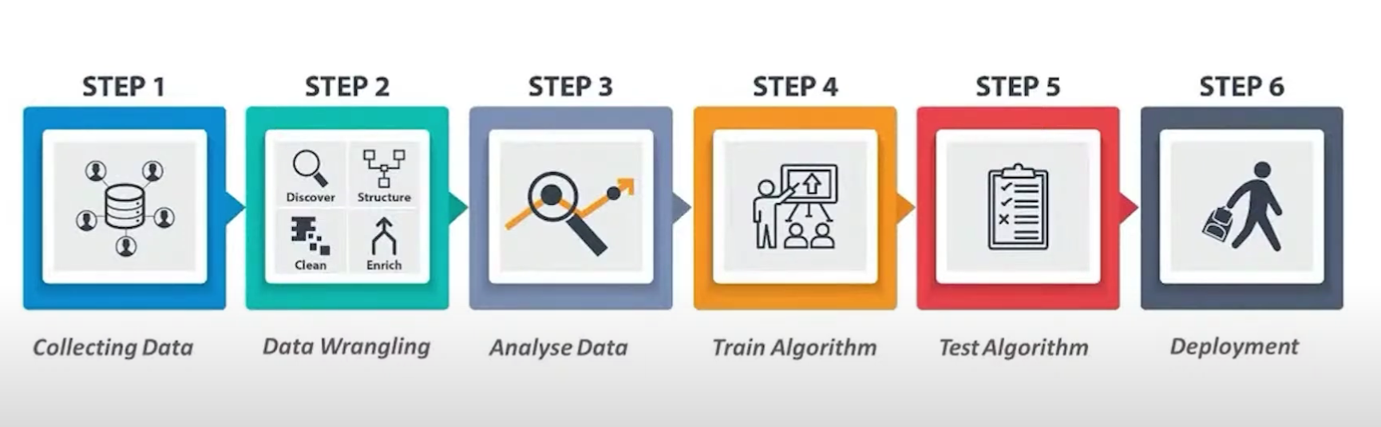

Slide 5
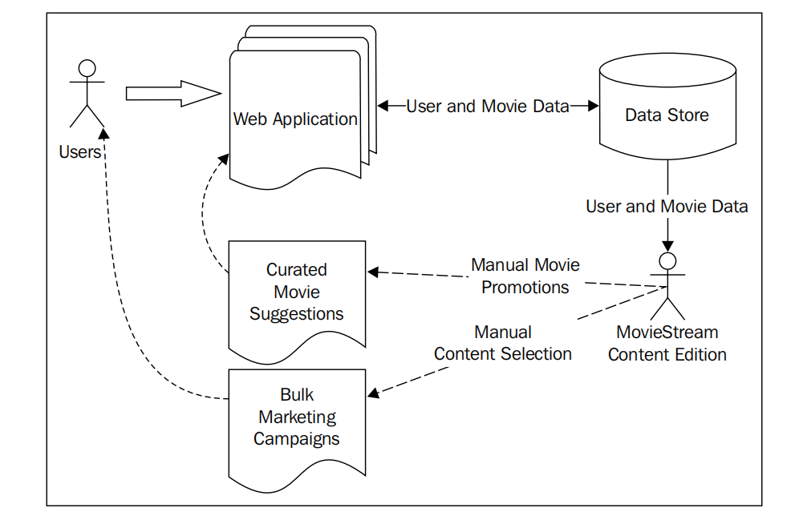
Movie Streams Example Architecture

Slide 6
Business use cases for a machine learning system
Why doesn’t MovieStream simply continue with human-driven decisions?
There are many reasons to use machine learning but the most important ones are mentioned here:
The scale of data involved means that full human involvement quickly becomes infeasible as MovieStream grows
Model-driven approaches such as machine learning and statistics can often benefit from uncovering patterns that cannot be seen by humans (due to the size and complexity of the datasets)
Model-driven approaches can avoid human and emotional biases (as long as the correct processes are carefully applied)

Slide 7
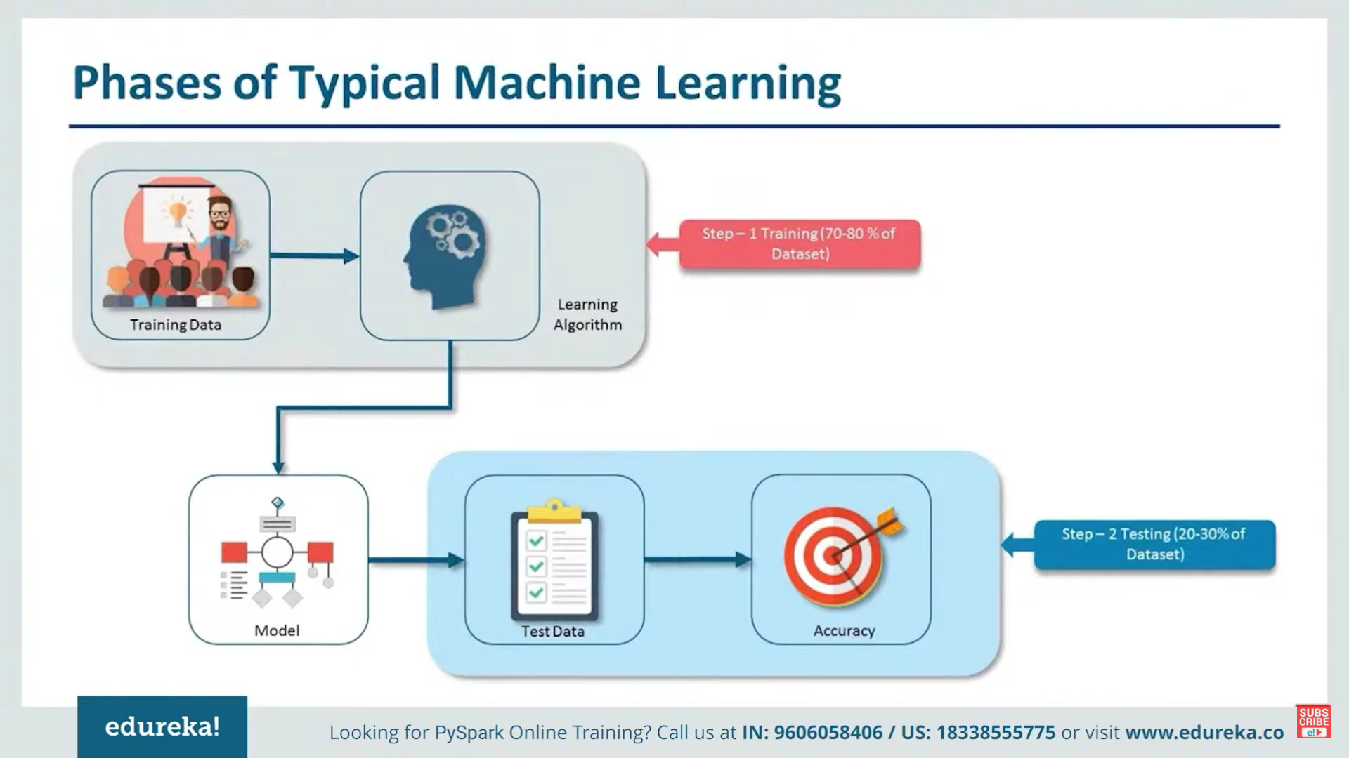

Slide 8
Personalization
Perhaps one of the most important potential applications of machine learning in MovieStream’s business is personalization.
Recommendations
These are essentially a subset of personalization. Recommendation generally refers to presenting a user with a list of items that we hope the user will be interested in.
Personalization is very similar to recommendations, but while recommendations
are usually focused on an explicit presentation of products or content to the user,
personalization is more generic and, often, more implicit.

Slide 9
Targeted marketing and customer segmentation
Targeted marketing uses a model to select what to target at users. While generally recommendations and personalization are focused on a one-to-one situation, segmentation approaches might try to assign users into groups based on characteristics and, possibly, behavioral data.
The approach might be fairly simple or might involve a machine learning model such as clustering.
Either way, the result is a set of segment assignments that might allow us to understand the broad characteristics of each group of users, what makes them similar to each other within a group, and what makes them different from others in different groups.

Slide 10
Predictive modeling and analytics
A third area where machine learning can be applied is in predictive analytics.
This is a very broad term, and in some ways, it encompasses recommendations, personalization, and targeting too. In this context, since recommendations and segmentation are somewhat distinct, we use the term predictive modeling to refer to other models that seek to make predictions.
MovieStream can use past activity and revenue data, together with content attributes, to create a regression model that can be used to make predictions for brand new titles.
As another example, we can use a classification model to automatically assign tags,
keywords, or categories to new titles for which we only have partial data.

Slide 11
Types of machine learning models
Supervised learning:
These types of models use labeled data to learn. Recommendation engines, regression, and classification are examples of supervised learning methods. The labels in these models can be user-movie ratings (for recommendation), movie tags (in the case of the preceding classification example), or revenue figures (for regression).

Slide 12
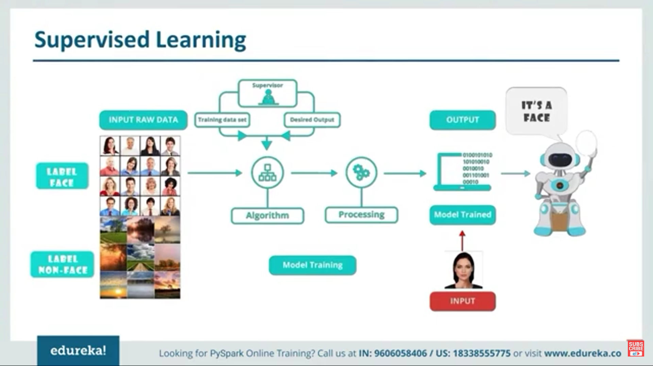

Slide 13
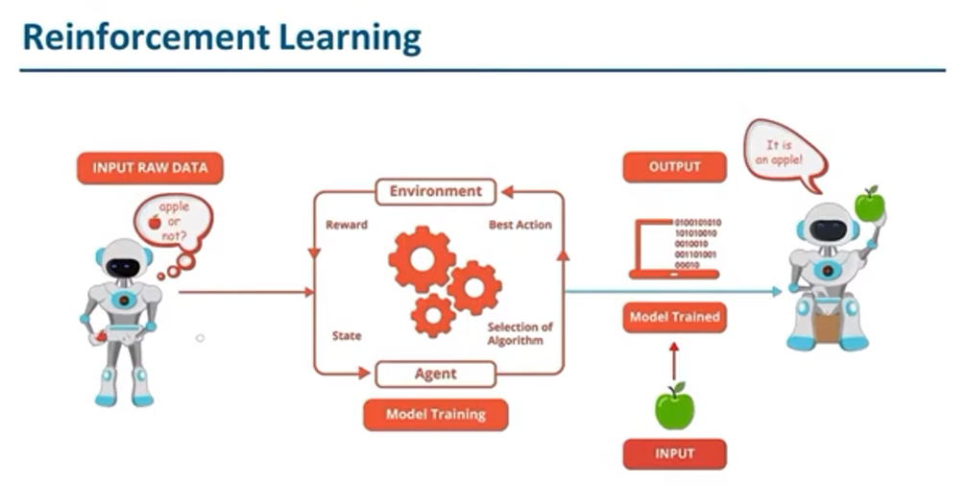

Slide 14
Unsupervised learning:
When a model does not require labeled data, we refer to unsupervised learning. These types of models try to learn or extract some underlying structure in the data or reduce the data down to its most important features. Clustering, dimensionality reduction, and some forms of feature extraction, such as text processing, are all unsupervised techniques.

Slide 15
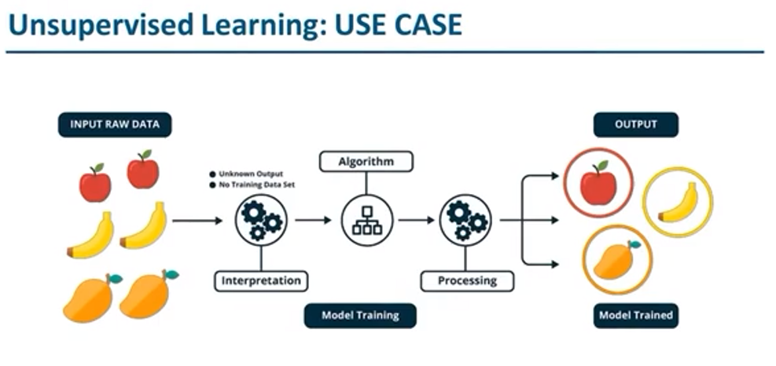

Slide 16
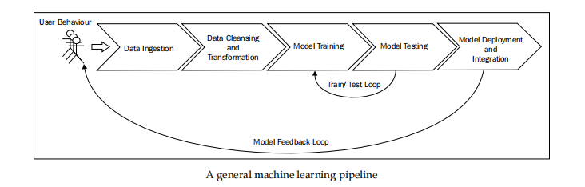
The components of a data-driven machine learning system

Slide 17
Data Ingestion
Data storage can be complex and involve a wide variety of systems, including HDFS,Amazon S3, and other filesystems; SQL databases such as MySQL or PostgreSQL; distributed NoSQL data stores such as HBase, Cassandra, and DynamoDB; and search engines such as Solr or Elasticsearch to stream data systems such as Kafka, Flume, or Amazon Kinesis.
Data cleansing and transformation
Filtering data
Dealing with missing, incomplete, or corrupted data
Dealing with potential anomalies, errors, and outliers
Joining together disparate data sources
Aggregating data

Slide 18
Model training and testing loop
During this phase, we are primarily concerned with model selection. This can refer to choosing the best modeling approach for our task, or the best parameter settings for a given model.
It is also common to explore the application of combinations of different models (known as ensemble methods) in this phase.
This is typically a fairly straightforward process of running our chosen model on our training dataset and testing its performance on a test dataset (that is, a set of data that is held out for the evaluation of the model that the model has not seen in the training phase). This process is referred to as Cross-validation.
Model deployment and integration
Model monitoring and feedback

Slide 19
Batch versus real time
There is a class of machine learning algorithms known as online learning; they update immediately as new data is fed into the model, thus enabling a real-time system.
A common example is an online-optimization algorithm for a linear model, such as stochastic gradient descent. The advantages of these methods are that the system can react very quickly to new information and also that the system can adapt to changes in the underlying behavior (that is, if the characteristics and distribution of the input data are changing over time, which is almost always the case in real-world situations).

Slide 20
Finally, batch-oriented frameworks might make it awkward to handle real-time processes of a streaming nature
.Fortunately, Spark’s real-time stream processing component, Spark Streaming, is a good potential fit for real-time machine learning workflows.
Due to the complexities inherent in a true real-time machine learning system, in practice, many systems target near real-time operations. This is essentially a hybrid approach where models are not necessarily updated immediately as new data arrives; instead, the new data is collected into mini-batches of a small set of training data.
These mini-batches can be fed to an online-learning algorithm. In many cases, this approach is combined with a periodic batch process that might recompute the model on the entire data set and perform more complex processing and model selection. This can help ensure that the real-time model does not degrade over time.

Slide 21
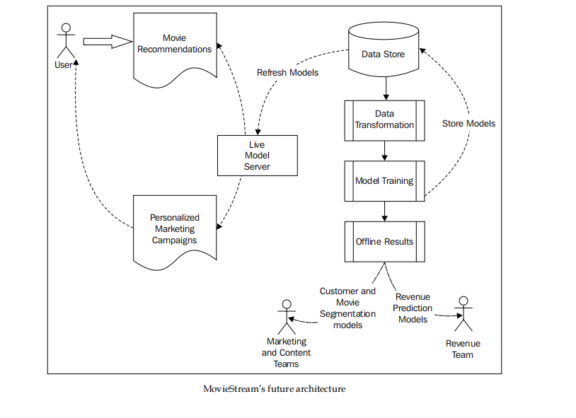
An architecture for a machine learning system

Slide 22
This system also includes:
Collecting data about users, their behavior, and our content titles
Transforming this data into features
Training our models, including our training-testing and model-selection phases
Deploying the trained models to both our live model-serving system as well as using these models for offline processes
Feeding back the model results into the MovieStream website through recommendation and targeting pages
Feeding back the model results into MovieStream’s personalized marketing channels
Using the offline models to provide tools to MovieStream’s various teams to better understand user behavior, characteristics of the content catalogue, and drivers of revenue for the business

Slide 23
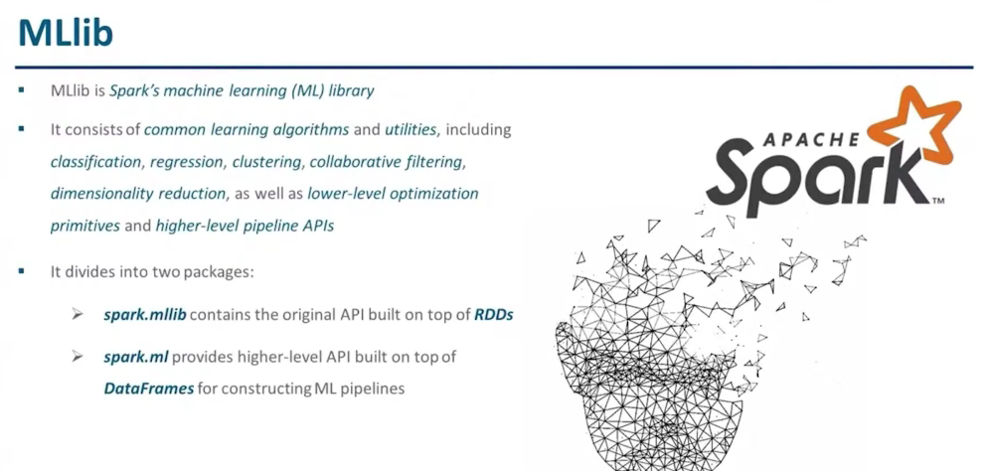

Slide 24
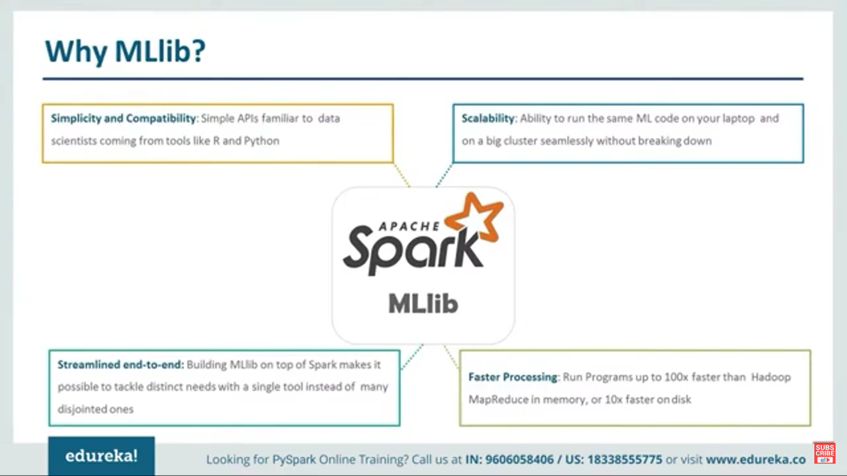

Slide 25
